Slide 1
Project - 1
Analysis on Topselling books in Amazon
Hive and HDFS
Presented by:
Venkata Naga Sri Sahithi Mulukutla

Slide 2
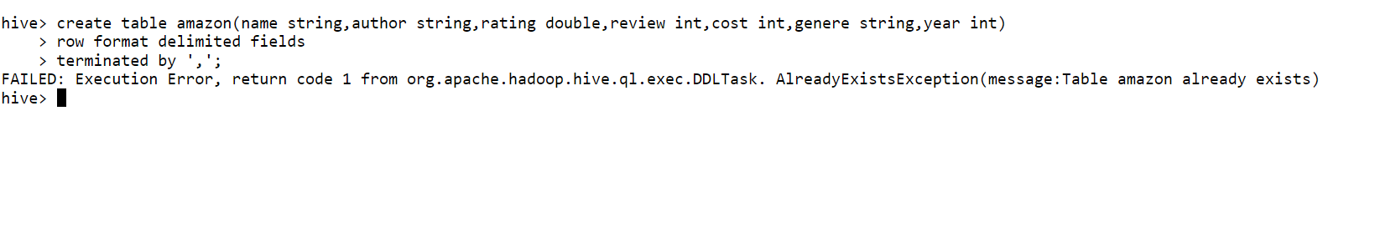
Hive Query for creating table

Slide 3
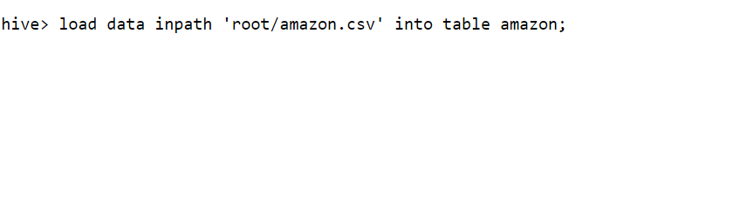
Hive Queries for loading data from HDFS to Hive Table

Slide 4
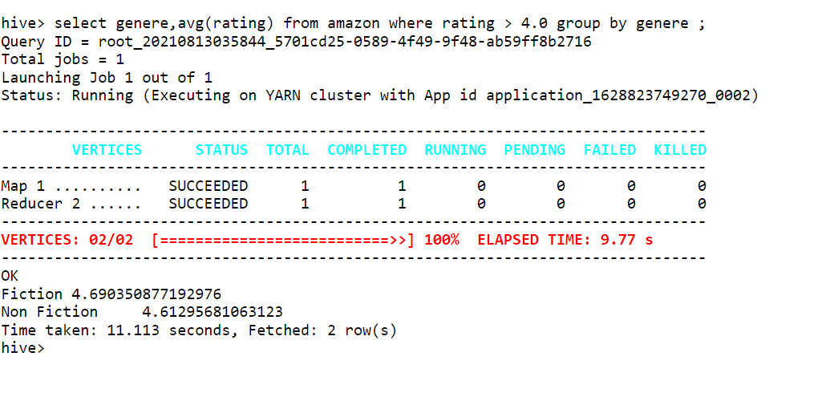
Hive Queries for retrieving average rating of genere of books whose rating is above 4

Slide 5
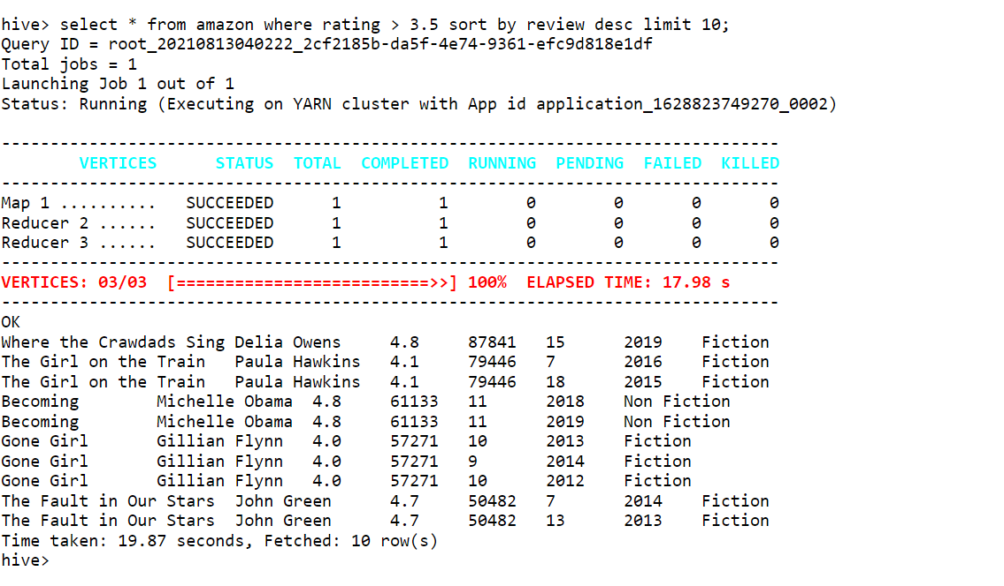
Hive Query for retrieving 10 book details whose rating is above 3.5 and sorting them using their reviews

Slide 6
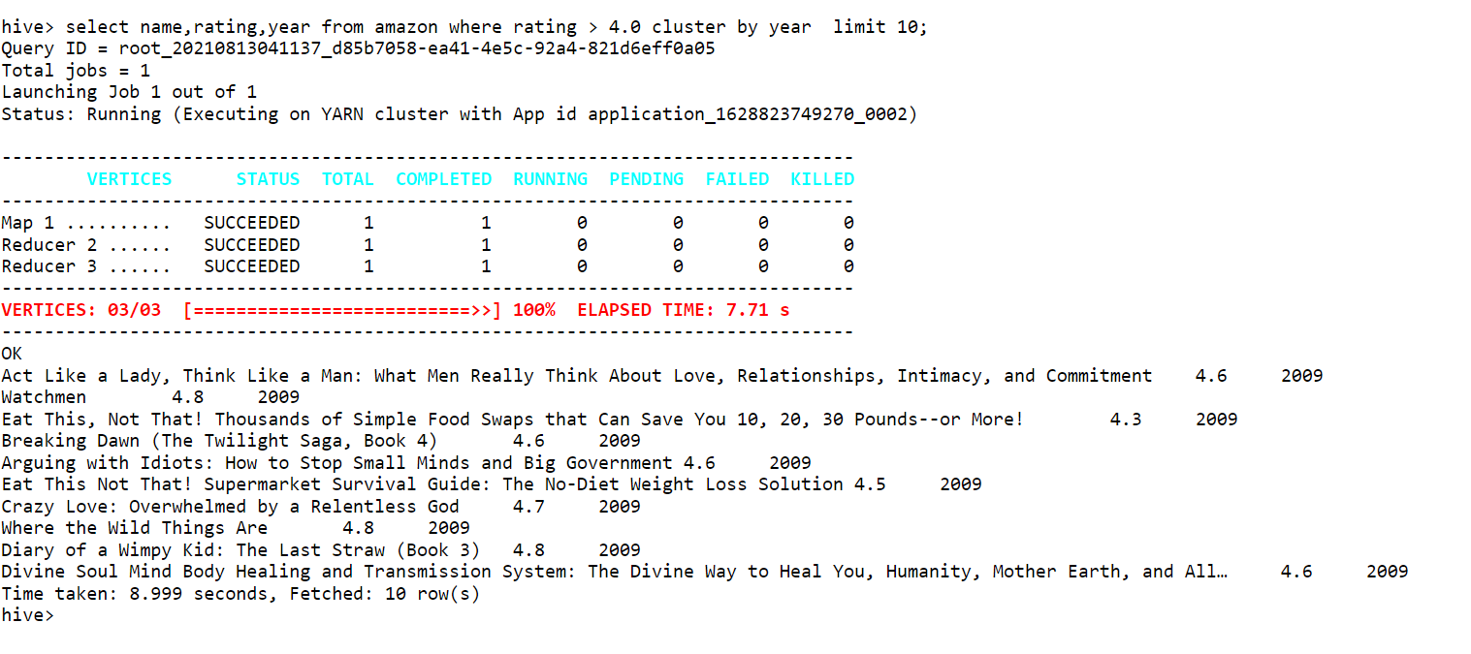
Hive Query for obtaining name and rating of 10 books and its release year whose rating above 4 and clustered by year

Slide 7
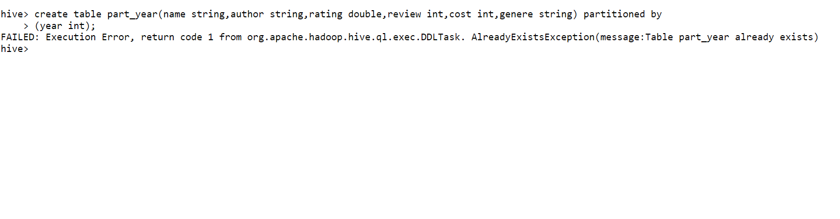
Hive Query for Creating Partition Table

Slide 8
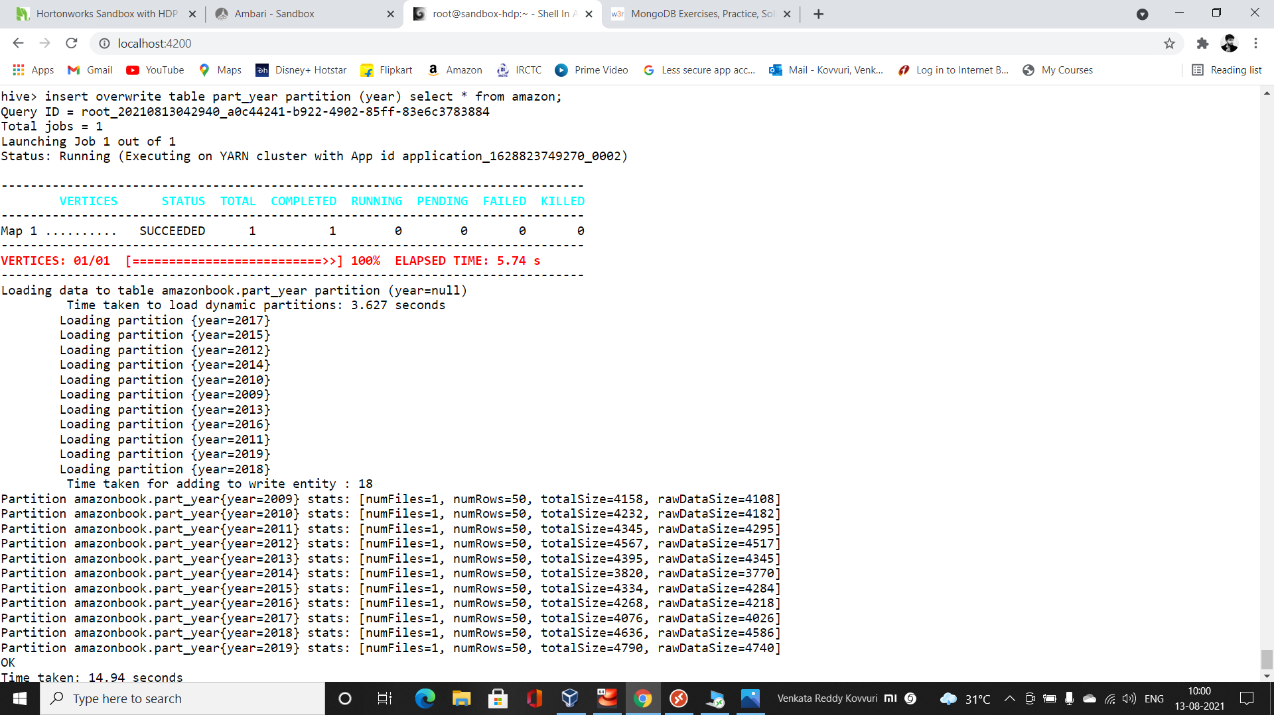
Hive Query for Overwriting Partition Table from Hive table

Slide 9
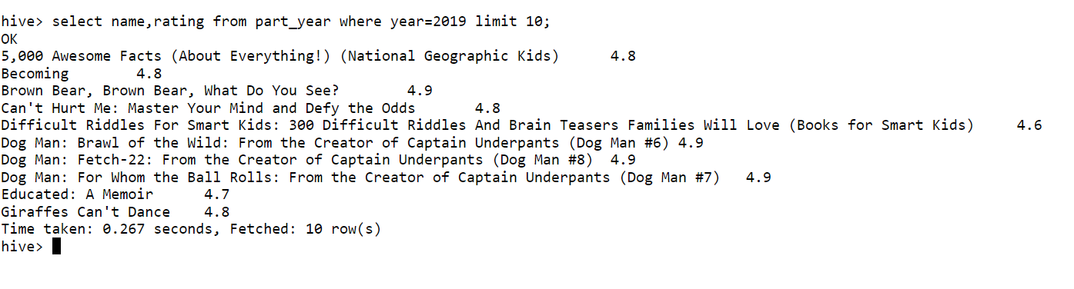
Hive Query for obtaining name and rating of top 10 amazon books which are released in 2019

Slide 10
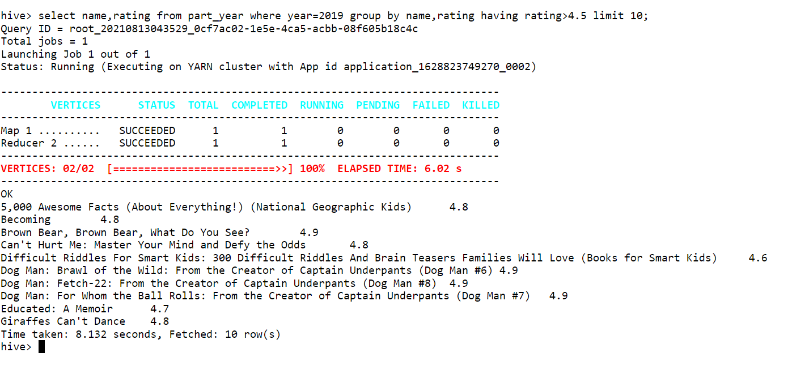
Hive Query for retrieving 10 Book names and rating from partitioned table which are released in 2019 grouping by name and rating above 4.5

Slide 11
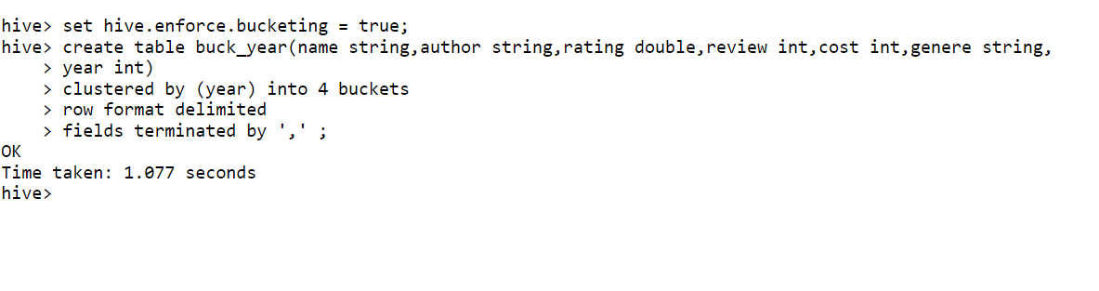
Hive Query for Creating Bucketing Table

Slide 12
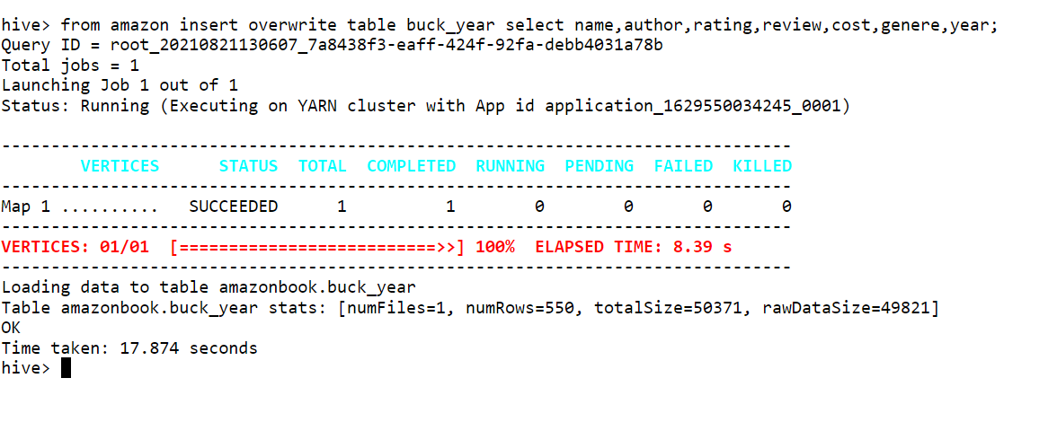
Hive Query for Overwriting Bucketed Table from Hive Table

Slide 13
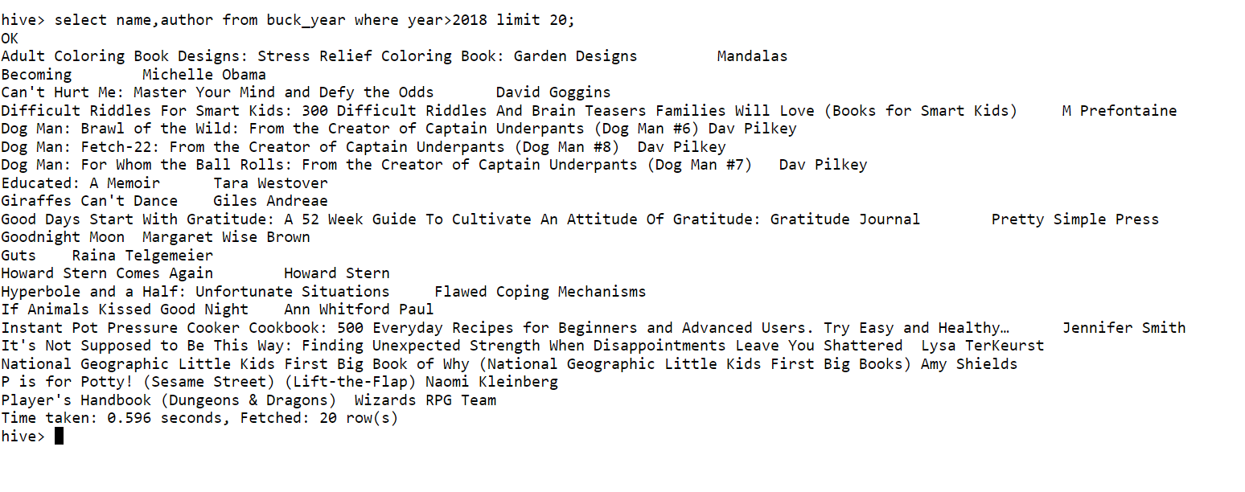
Hive Query for obtaining top 20 Book names and its author which are released after 2018

Slide 14
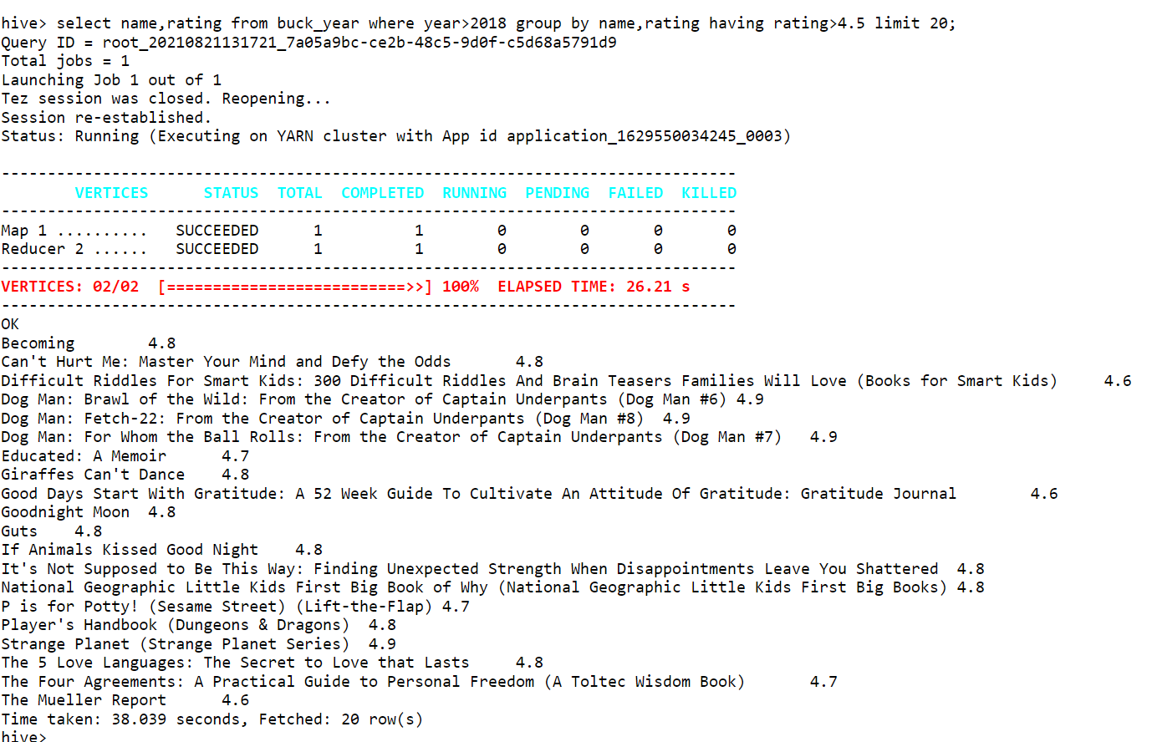
Hive Query for obtaining Top 20 Book names , ratings from Bucketed table which are released after 2018 having rating above 4.5 grouping by name and its rating

Slide 15
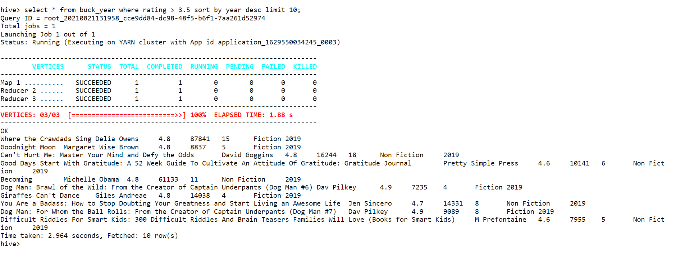
Hive Query for retrieving 10 Book Details from Bucketed table whose rating is above 3.5 and those are sorted by their year which are recently released

